Slide 1
Lecture 5: Review of Neural Networks

Slide 2
Artificial Neural Networks
Machine Learning Algorithm
Very simplified parametric models of our brain
Networks of basic processing units: neurons
Neurons store information which has to be learned (the weights or the state for RNNs)
Many types of architectures to solve different tasks
They can scale to massive data
...
...
...
...
...
99.9%
dog

Slide 3
Outline
Anatomy of a NN
Design choices
Learning

Slide 4
Review of Feed Forward Artificial Neural Networks
Anatomy of a NN
Design choices
Activation function
Loss function
Output units
Architecture
Learning

Slide 5
Review of Feed Forward Artificial Neural Networks
Anatomy of a NN
Design choices
Activation function
Loss function
Output units
Architecture
Learning

Slide 6
Anatomy of artificial neural network (ANN)
neuron
node
input
output
X
Y

Slide 7
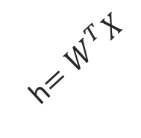
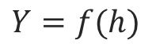
Anatomy of artificial neural network (ANN)
neuron
node
input
output
Affine transformation
$$Y=f(h)$$
Activation
X
Y
h$=W^{T}X$
We will talk later about the choice of activation function.

Slide 8
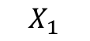

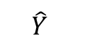
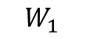
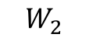
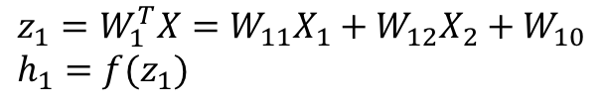
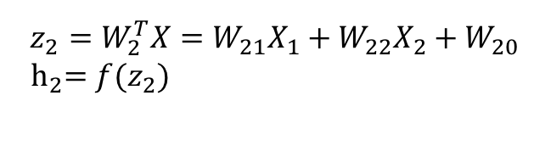
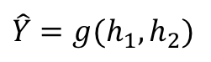
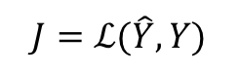
Anatomy of artificial neural network (ANN)
Input layer
hidden layer
output layer
$$z_{1}=W_{1}^{T}X=W_{11}X_{1}+W_{12}X_{2}+W_{10} \\ h_{1}=f(z_{1})$$
$$X_{1}$$
$$W_{1}$$
$$\hat{Y}$$
$$\hat{Y}=g(h_{1},h_{2})$$
$$J=ℒ(\hat{Y},Y)$$
Output function
Loss function
$$X_{2}$$
$$W_{2}$$
$$z_{2}=W_{2}^{T}X=W_{21}X_{1}+W_{22}X_{2}+W_{20}$$
$${ h}_{2}=f(z_{2})$$
We will talk later about the choice of the output layer and the loss function.

Slide 9
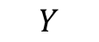
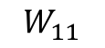
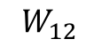
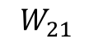
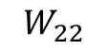
Anatomy of artificial neural network (ANN)
Input layer
hidden layer 1
hidden layer 2
output layer
$$X_{1}$$
$$W_{11}$$
$$W_{21}$$
$$Y$$
$$X_{2}$$
$$W_{12}$$
$$W_{22}$$

Slide 10
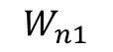
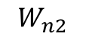
Anatomy of artificial neural network (ANN)
Input layer
hidden layer 1
hidden layer n
output layer
$$X_{1}$$
$$W_{11}$$
…
$$W_{n1}$$
$$Y$$
$$X_{2}$$
$$W_{12}$$
…
$$W_{n2}$$
We will talk later about the choice of the number of layers.

Slide 11
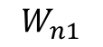
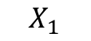
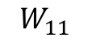
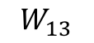
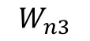
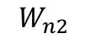
Anatomy of artificial neural network (ANN)
Input layer
hidden layer 1, 3 nodes
hidden layer n
3 nodes
output layer
$$W_{n1}$$
$$W_{11}$$
$$X_{1}$$
$$W_{12}$$
…
$$W_{n2}$$
$$Y$$
$$X_{2}$$
$$W_{13}$$
$$W_{n3}$$

Slide 12
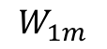
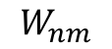
Anatomy of artificial neural network (ANN)
Input layer
hidden layer 1,
hidden layer n
output layer
m nodes
$$W_{n1}$$
$$W_{11}$$
$$X_{1}$$
m nodes
…
…
$$Y$$
$$X_{2}$$
$$W_{1m}$$
$$W_{nm}$$
We will talk later about the choice of the number of nodes.

Slide 13
Anatomy of artificial neural network (ANN)
Input layer
hidden layer 1,
hidden layer n
output layer
m nodes
$$W_{n1}$$
$$W_{11}$$
$$X_{1}$$
m nodes
Number of inputs d
…
…
$$Y$$
$$X_{2}$$
$$W_{1m}$$
$$W_{nm}$$
Number of inputs is specified by the data

Slide 14
Review of Feed Forward Artificial Neural Networks
Anatomy of a NN
Design choices
Activation function
Loss function
Output units
Architecture
Learning

Slide 15
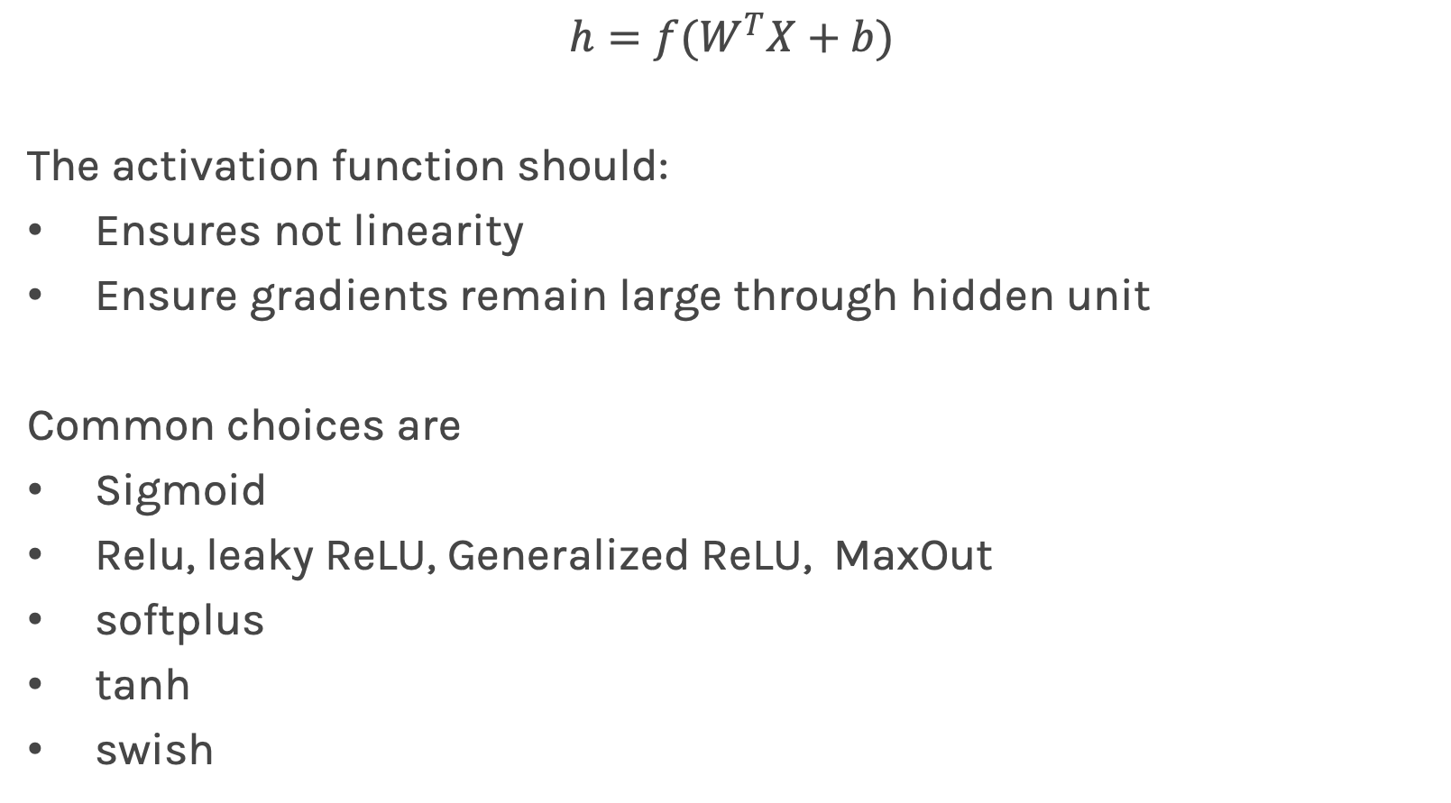
Activation function
$$h=f(W^{T}X+b)$$
The activation function should:
Ensures not linearity
Ensure gradients remain large through hidden unit
Common choices are
Sigmoid
Relu, leaky ReLU, Generalized ReLU, MaxOut
softplus
tanh
swish

Slide 16
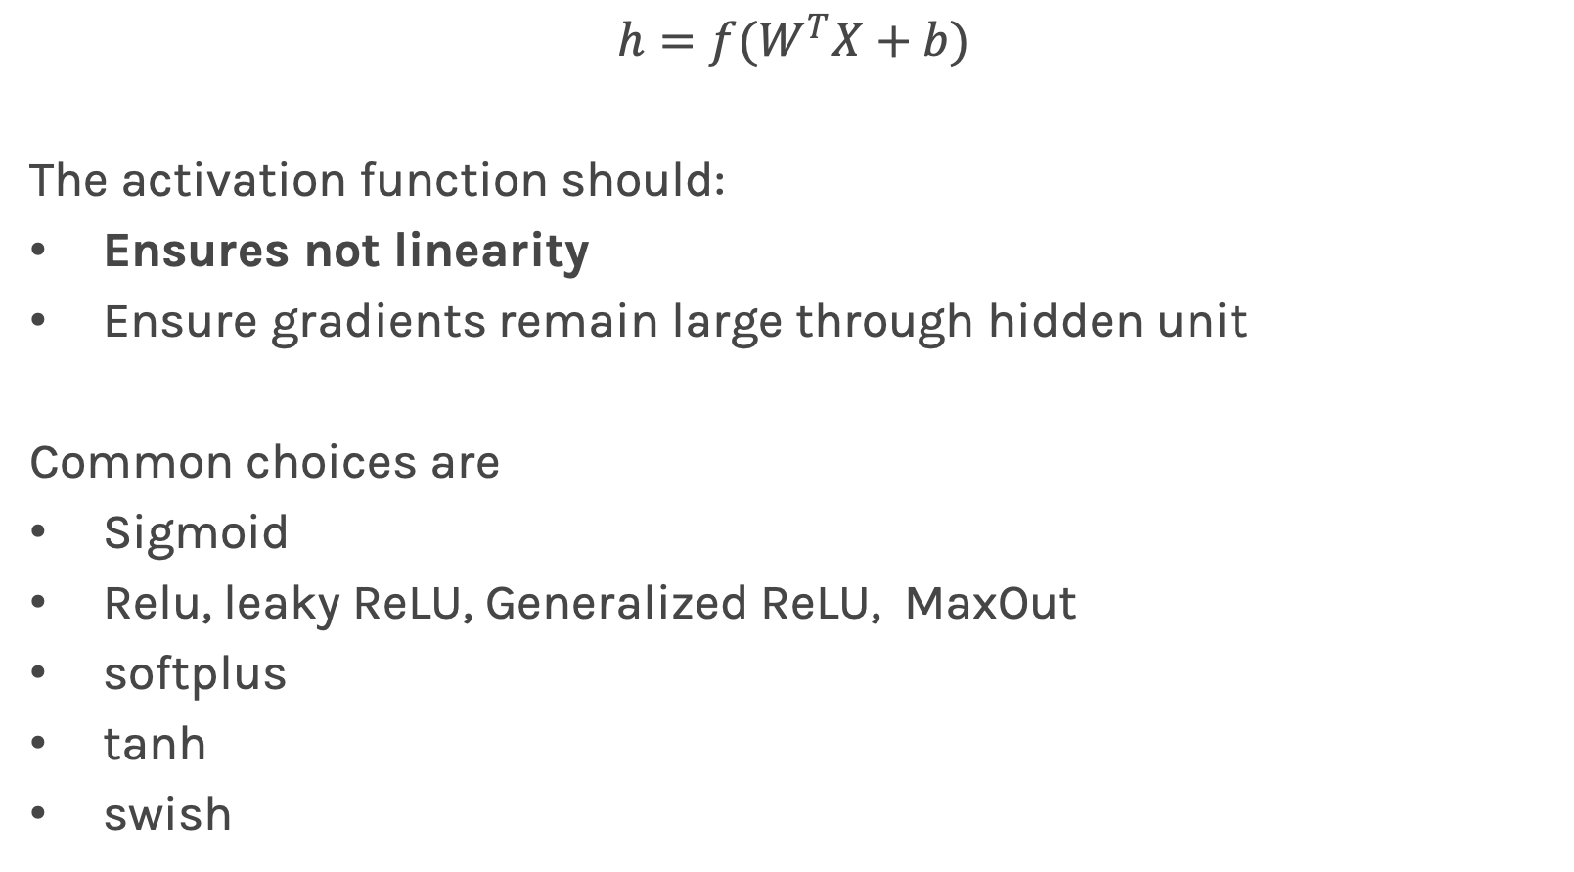
Activation function
$$h=f(W^{T}X+b)$$
The activation function should:
Ensures not linearity
Ensure gradients remain large through hidden unit
Common choices are
Sigmoid
Relu, leaky ReLU, Generalized ReLU, MaxOut
softplus
tanh
swish

Slide 17
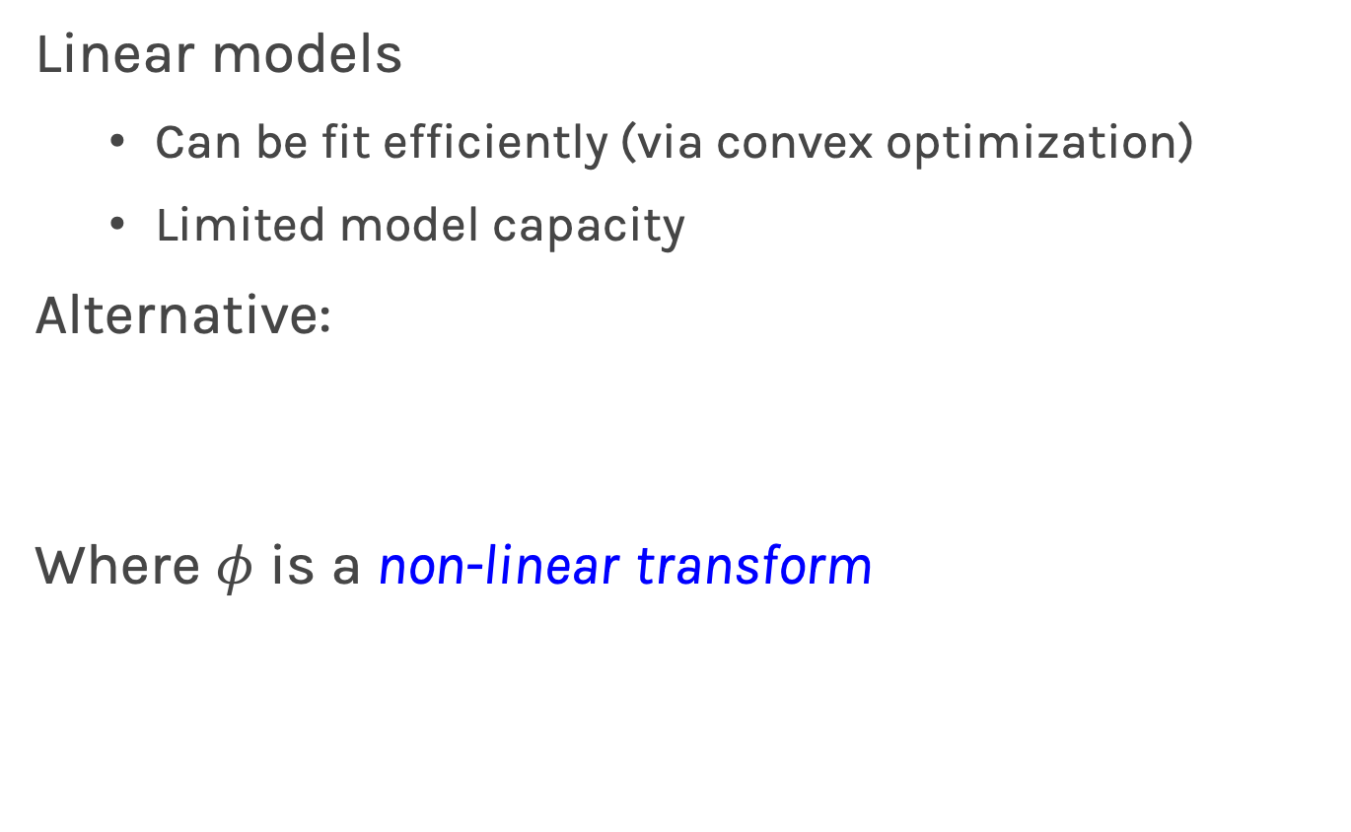
Beyond Linear Models
Linear models
Can be fit efficiently (via convex optimization)
Limited model capacity
Alternative:
Where $φ$ is a non-linear transform

Slide 18
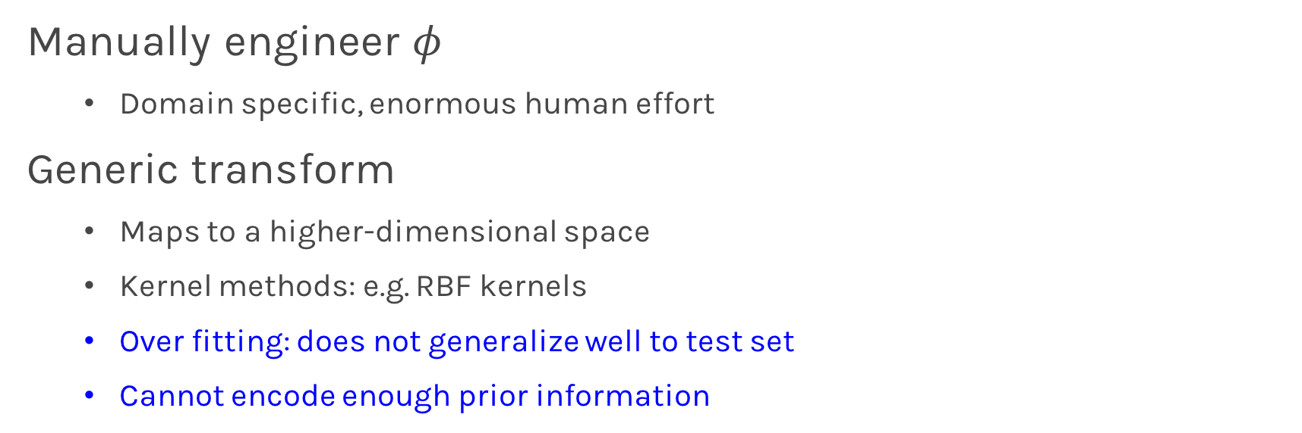
Traditional ML
Manually engineer $φ$
Domain specific, enormous human effort
Generic transform
Maps to a higher-dimensional space
Kernel methods: e.g. RBF kernels
Over fitting: does not generalize well to test set
Cannot encode enough prior information

Slide 19
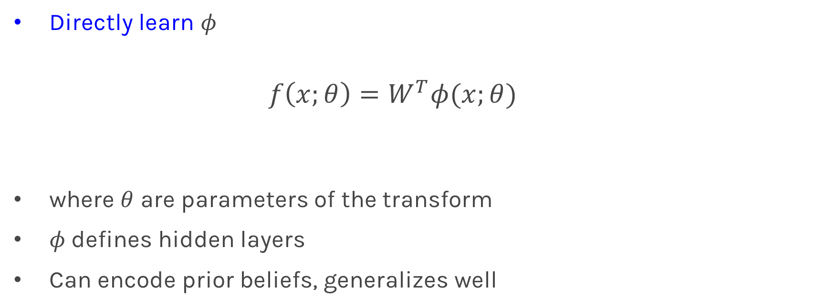
Deep Learning
Directly learn $φ$
$$f\left(x;θ\right)=W^{T}φ(x;θ)$$
where $θ$ are parameters of the transform
$φ$defines hidden layers
Can encode prior beliefs, generalizes well

Slide 20
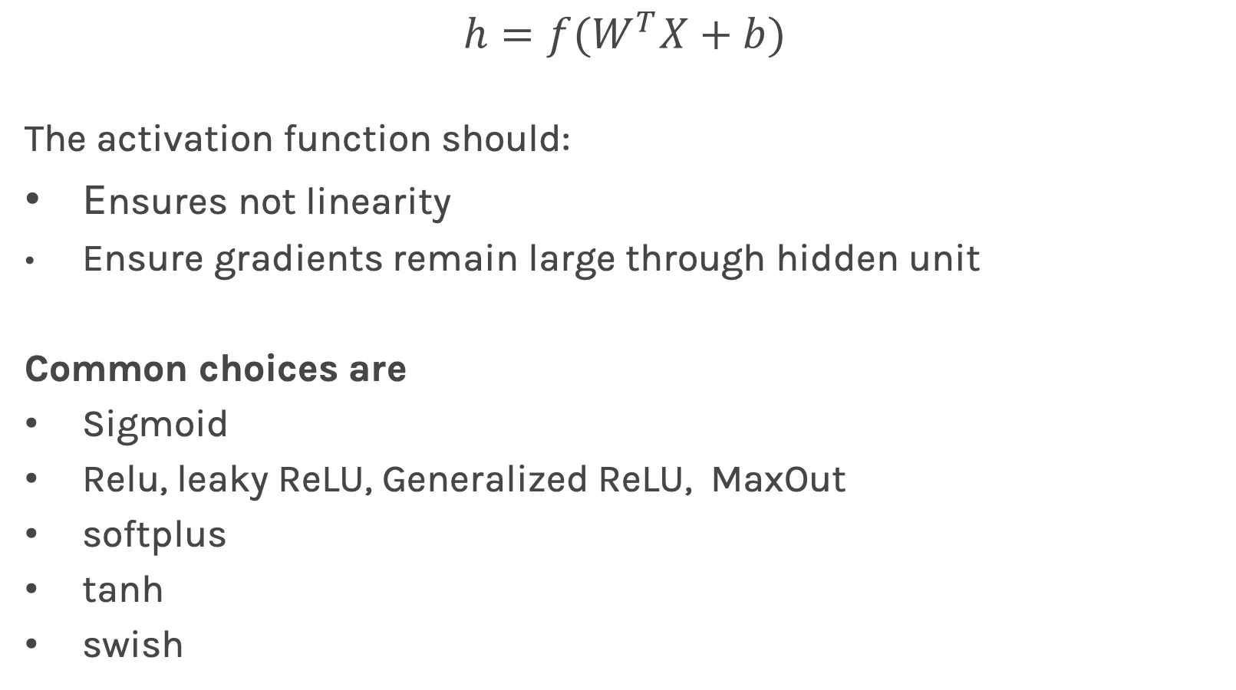
Activation function
$$h=f(W^{T}X+b)$$
The activation function should:
Ensures not linearity
Ensure gradients remain large through hidden unit
Common choices are
Sigmoid
Relu, leaky ReLU, Generalized ReLU, MaxOut
softplus
tanh
swish

Slide 21
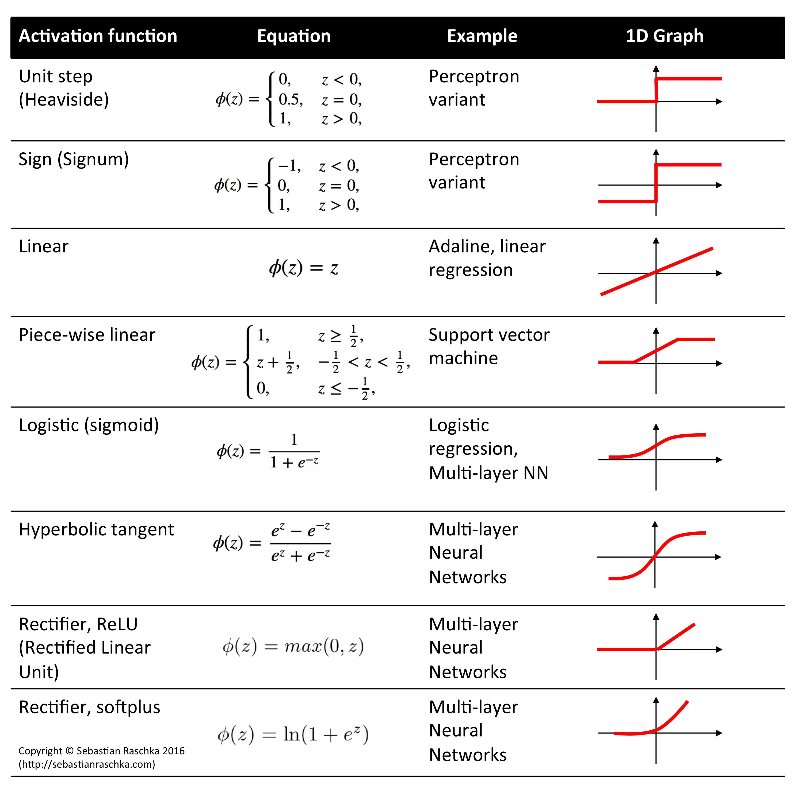

Slide 22
Review of Feed Forward Artificial Neural Networks
Anatomy of a NN
Design choices
Activation function
Loss function
Output units
Architecture
Learning

Slide 23
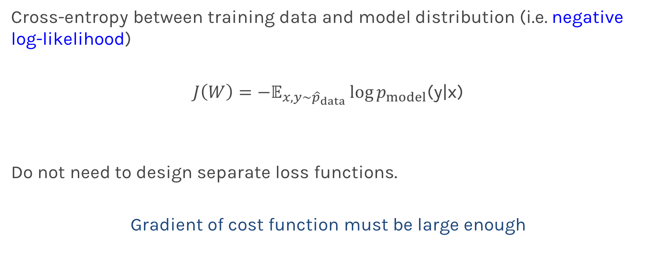
Loss Function
Cross-entropy between training data and model distribution (i.e. negative log-likelihood)
$J\left(W\right)=−𝔼_{x,y\sim {\hat{p}}_{data}}\log{p_{model}}$(y|x)
Do not need to design separate loss functions.
Gradient of cost function must be large enough

Slide 24
Review of Feed Forward Artificial Neural Networks
Anatomy of a NN
Design choices
Activation function
Loss function
Output units
Architecture
Learning

Slide 25
Output Units
Output Type | Output Distribution | Output layer | Cost Function
Binary

Slide 26
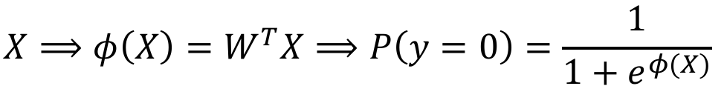
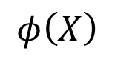
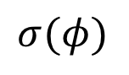
Link function
$$X⟹φ\left(X\right)=W^{T}X⟹P\left(y=0\right)=\frac{1}{1+e^{φ(X)}}$$
X
Y
OUTPUT UNIT
X
$$φ\left(X\right)$$
$$σ(φ)$$
Y

Slide 27
Output Units
Output Type | Output Distribution | Output layer | Cost Function
Binary | Bernoulli | Sigmoid | Binary Cross Entropy

Slide 28
Output Units
Output Type | Output Distribution | Output layer | Cost Function
Binary | Bernoulli | Sigmoid | Binary Cross Entropy
Discrete

Slide 29
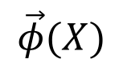
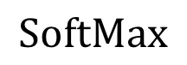
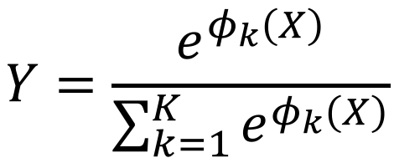
Link function multi-class problem
X
Y
OUTPUT UNIT
$$Y=\frac{e^{φ_{k}\left(X\right)}}{\sum_{k=1}^{K}{e^{φ_{k}\left(X\right)}}}$$
X
$$\vec{φ}(X)$$
$$SoftMax$$

Slide 30
Output Units
Output Type | Output Distribution | Output layer | Cost Function
Binary | Bernoulli | Sigmoid | Binary Cross Entropy
Discrete | Multinoulli | Softmax | Cross Entropy

Slide 31
Output Units
Output Type | Output Distribution | Output layer | Cost Function
Binary | Bernoulli | Sigmoid | Binary Cross Entropy
Discrete | Multinoulli | Softmax | Cross Entropy
Continuous | Gaussian | Linear | MSE

Slide 32
Output Units
Output Type | Output Distribution | Output layer | Cost Function
Binary | Bernoulli | Sigmoid | Binary Cross Entropy
Discrete | Multinoulli | Softmax | Cross Entropy
Continuous | Gaussian | Linear | MSE
Continuous | Arbitrary | - | GANS

Slide 33
Review of Feed Forward Artificial Neural Networks
Anatomy of a NN
Design choices
Activation function
Loss function
Output units
Architecture
Learning

Slide 34
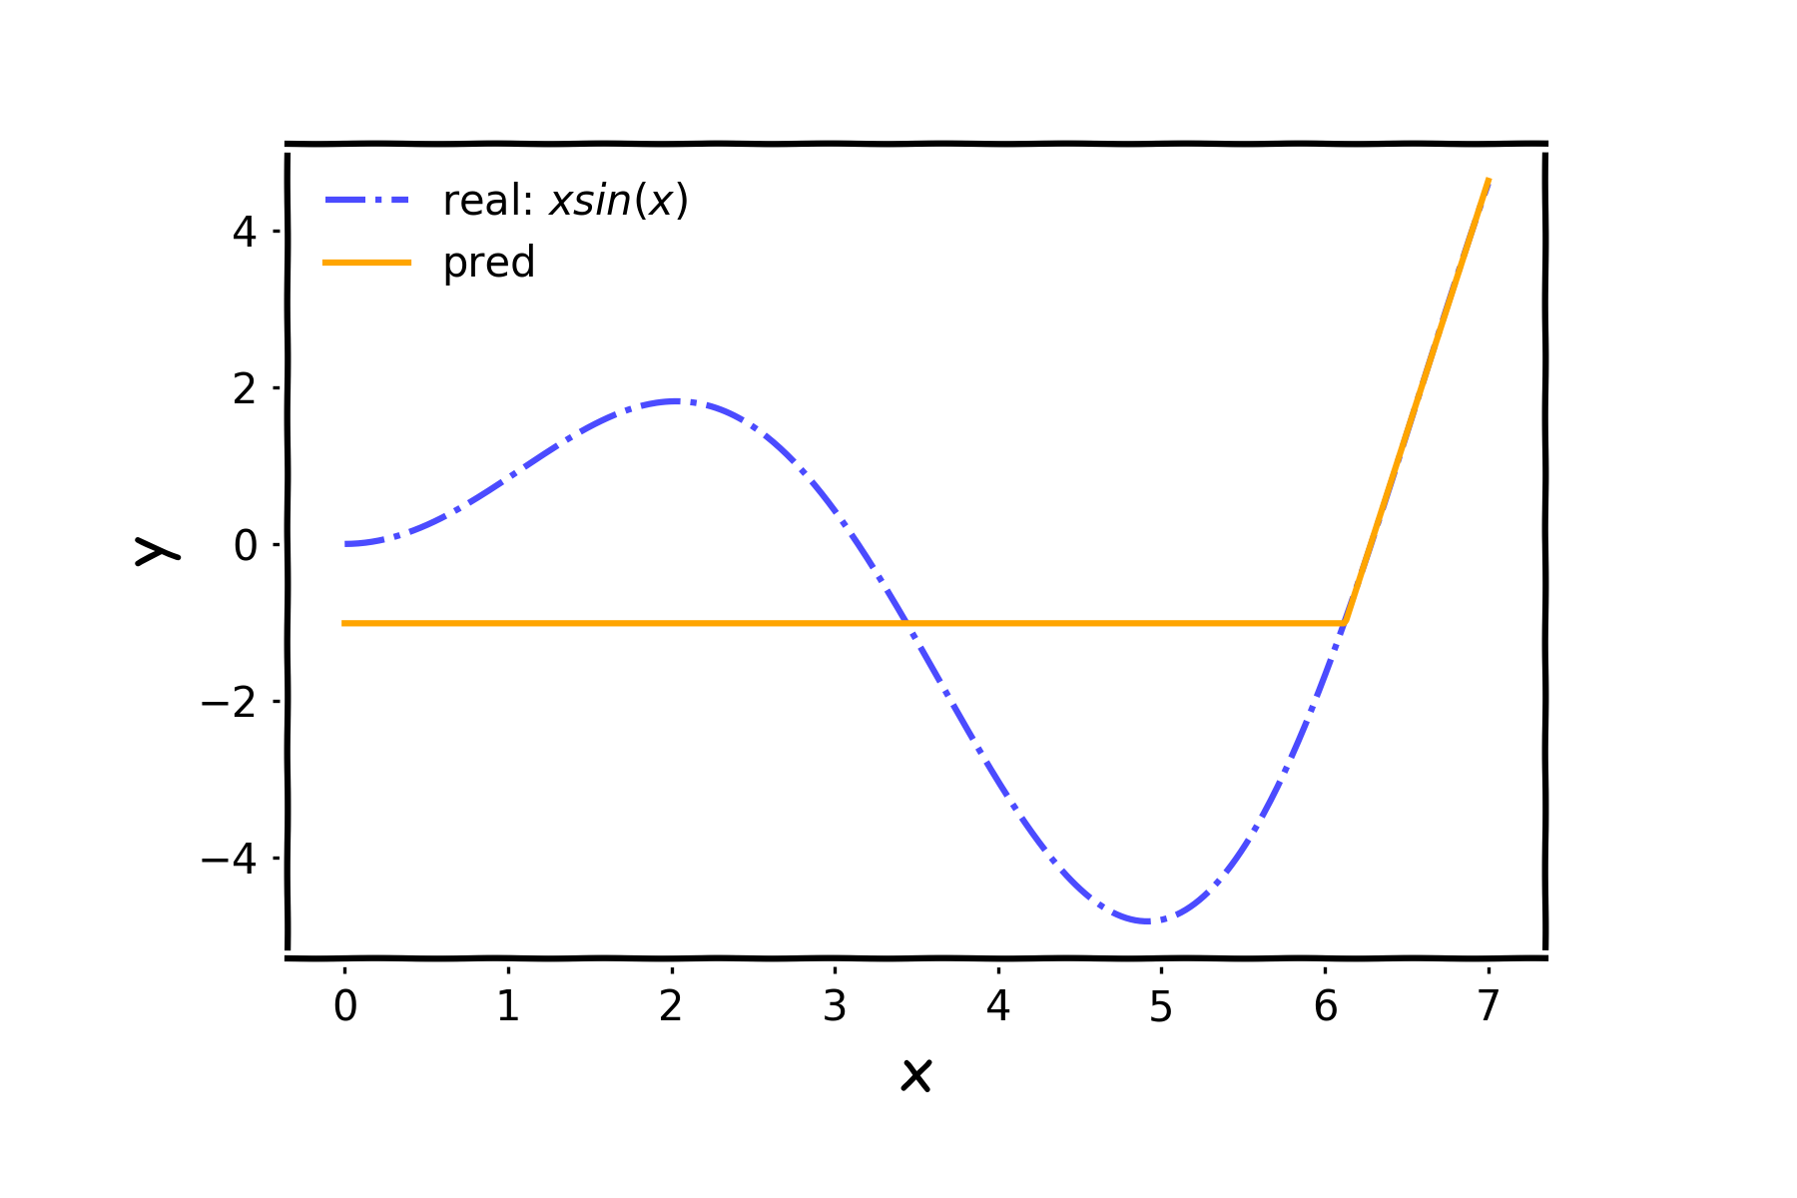
Architecture

Slide 35
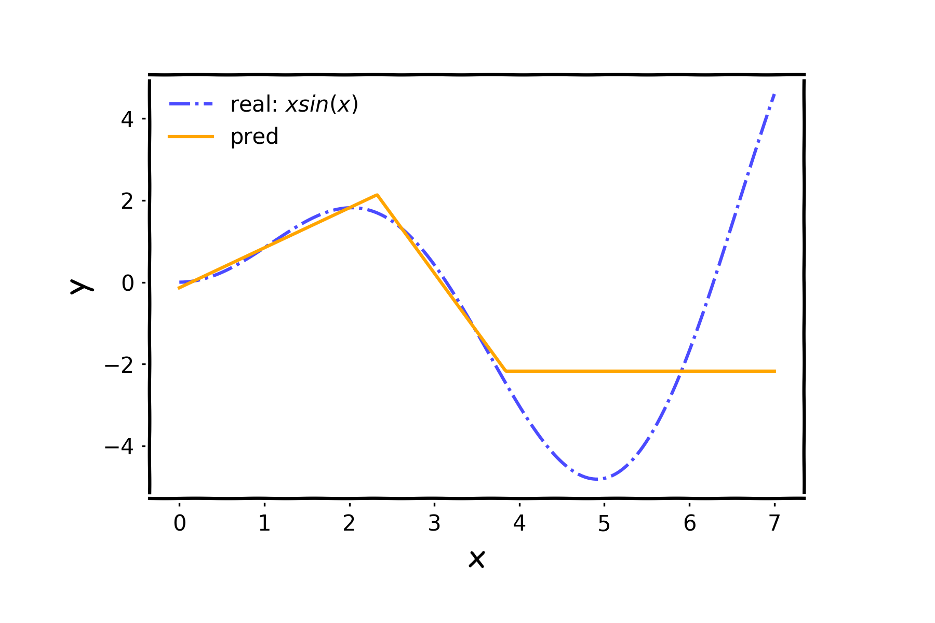
Architecture (cont)

Slide 36
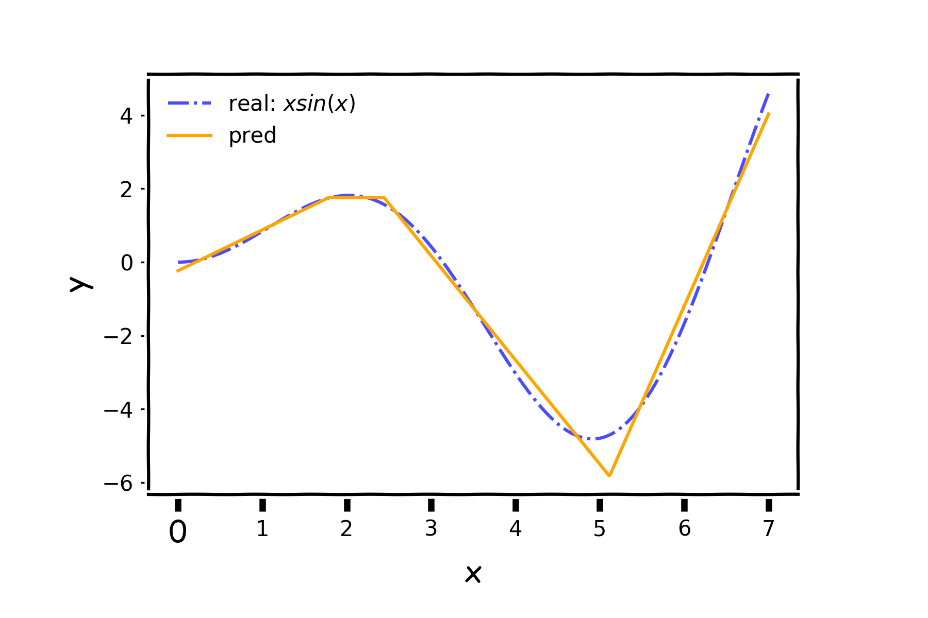
Architecture (cont)

Slide 37
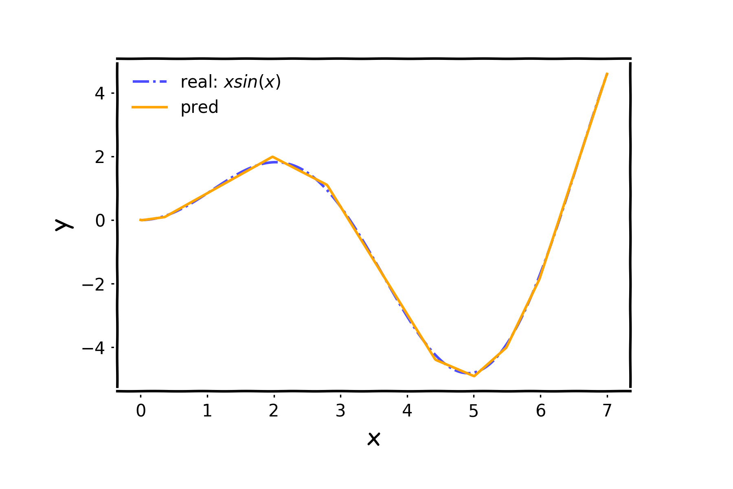
Architecture (cont)
…

Slide 38
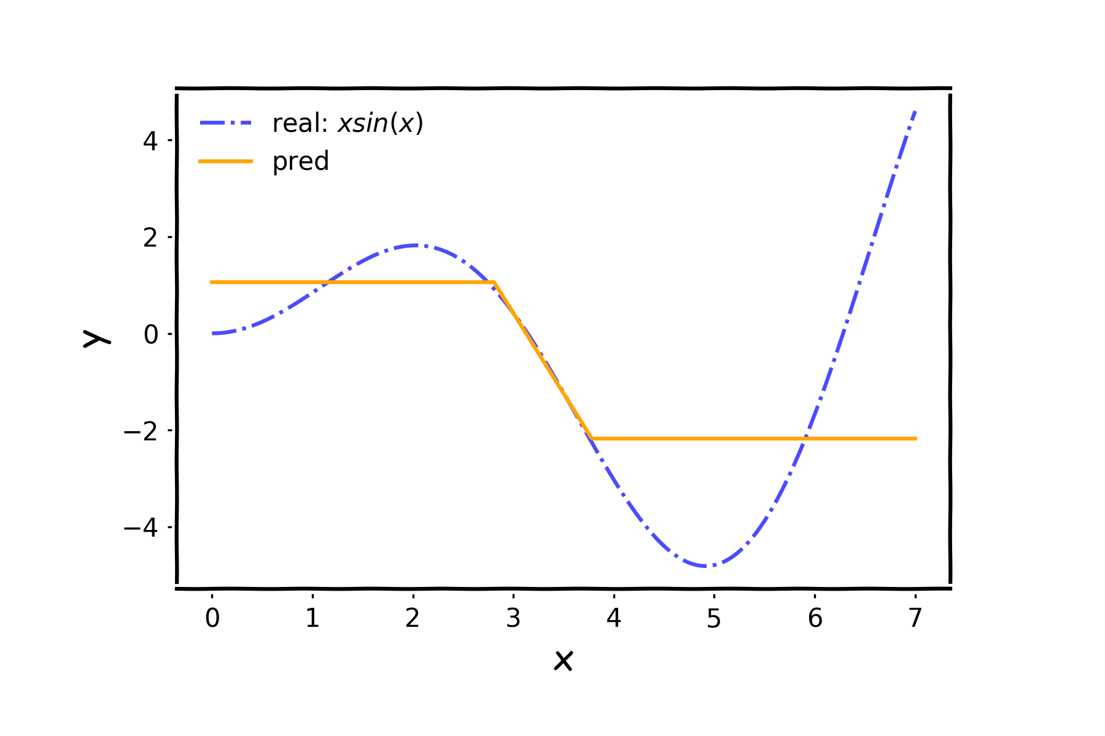
Architecture (cont)

Slide 39
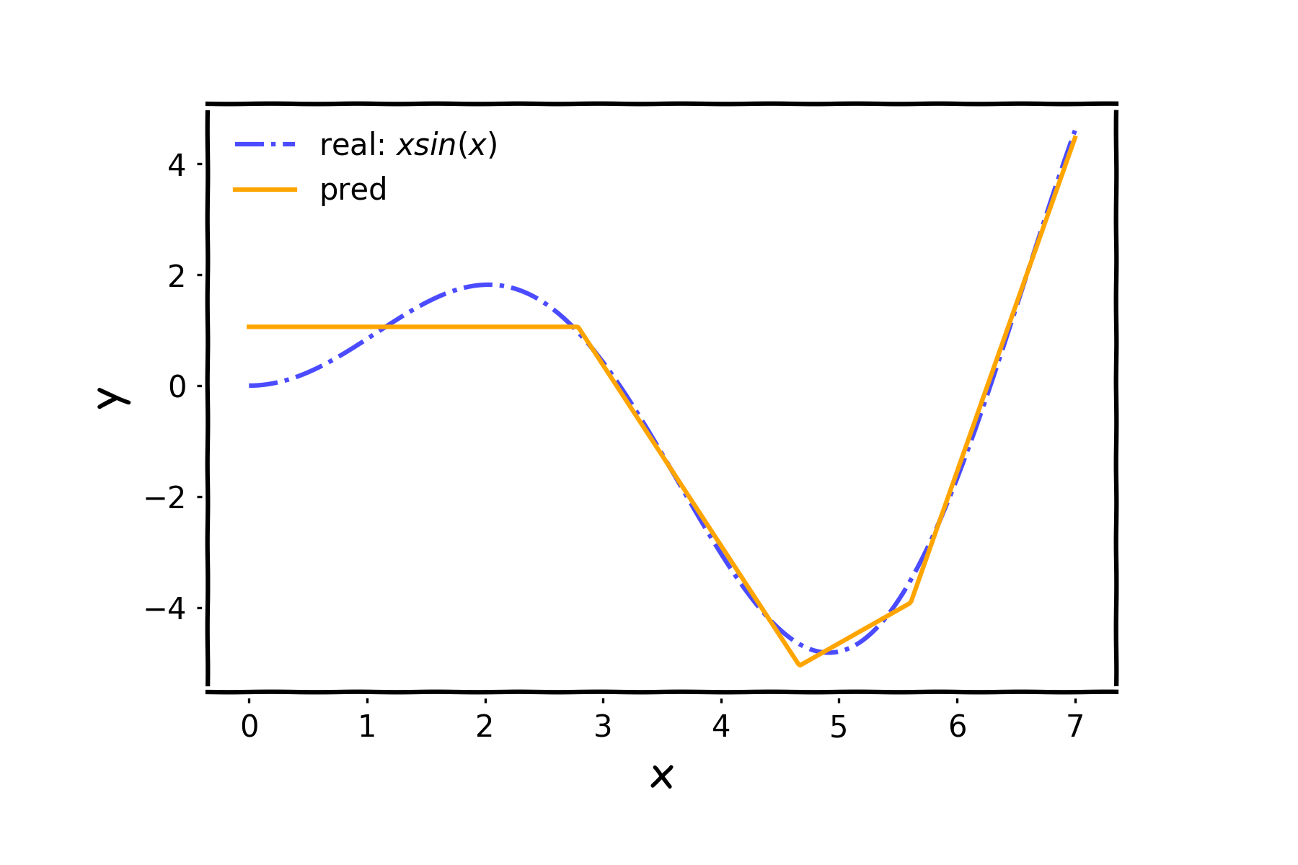
Architecture (cont)

Slide 40
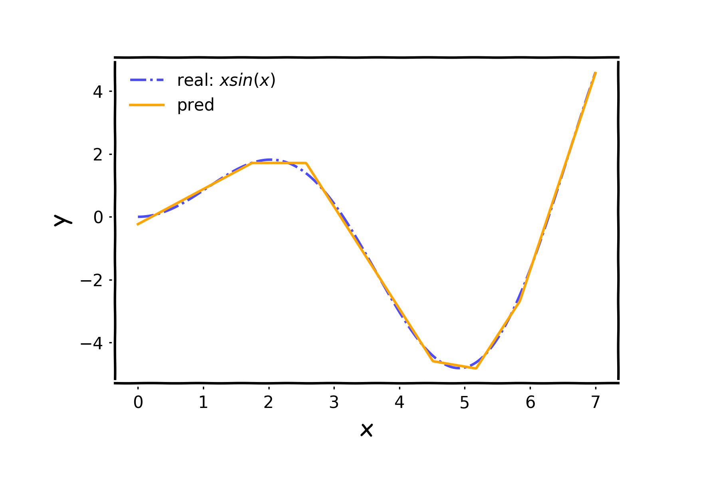
Architecture (cont)

Slide 41
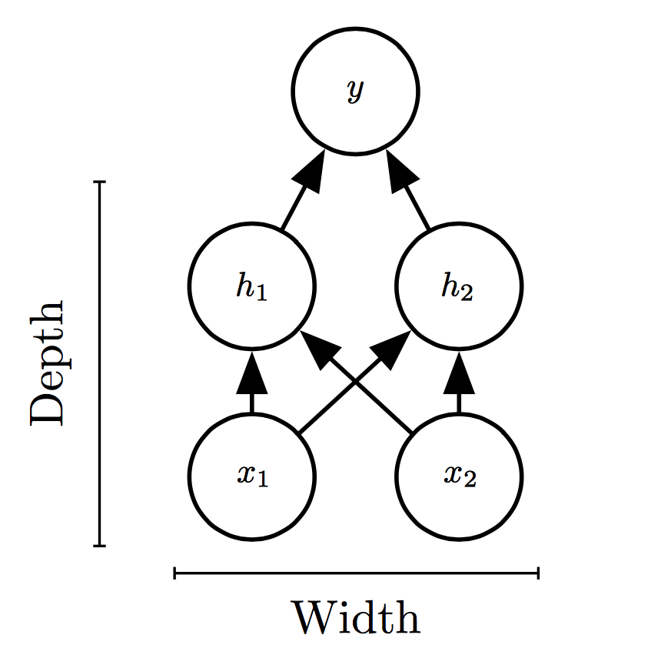
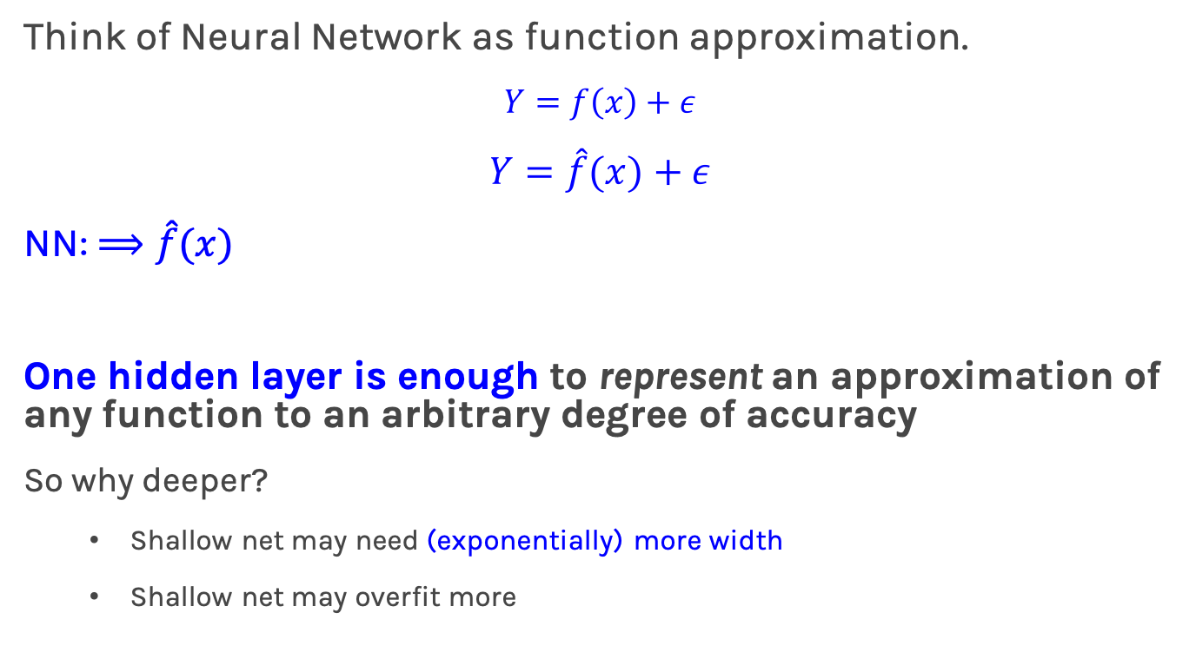
Universal Approximation Theorem
Think of Neural Network as function approximation.
$$Y=f\left(x\right)+ε$$
$$Y=\hat{f}(x)+ε$$
NN: $⟹\hat{f}(x)$
One hidden layer is enough to represent an approximation of any function to an arbitrary degree of accuracy
So why deeper?
Shallow net may need (exponentially) more width
Shallow net may overfit more

Slide 42
What does an astronomer blow with gum?
Hubbles

Slide 43
Auditors: Volunteers

Slide 44

Notes:
LiveSlide Site
https://harvard-iacs.github.io/2019-CS109B/

Slide 45
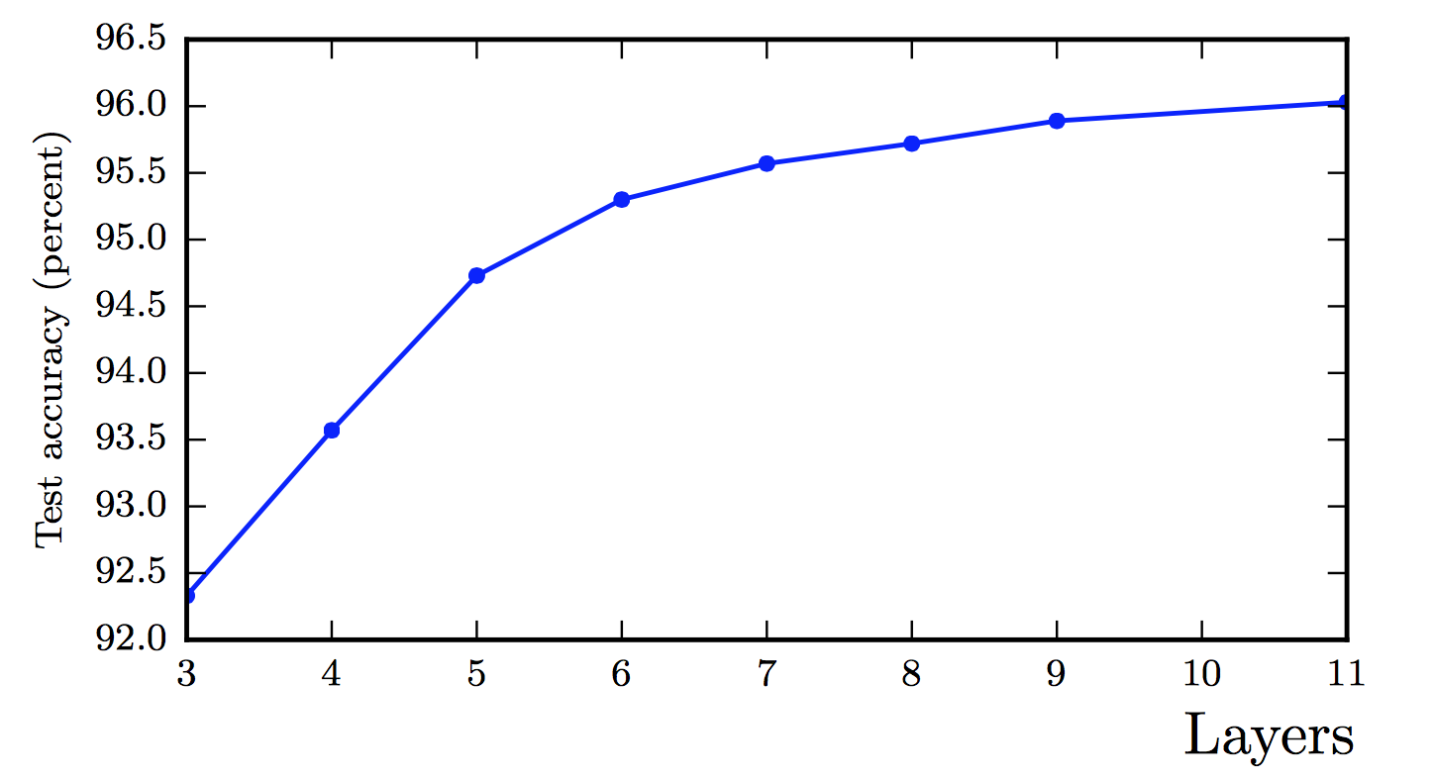
Better Generalization with Depth
(Goodfellow 2017)

Slide 46
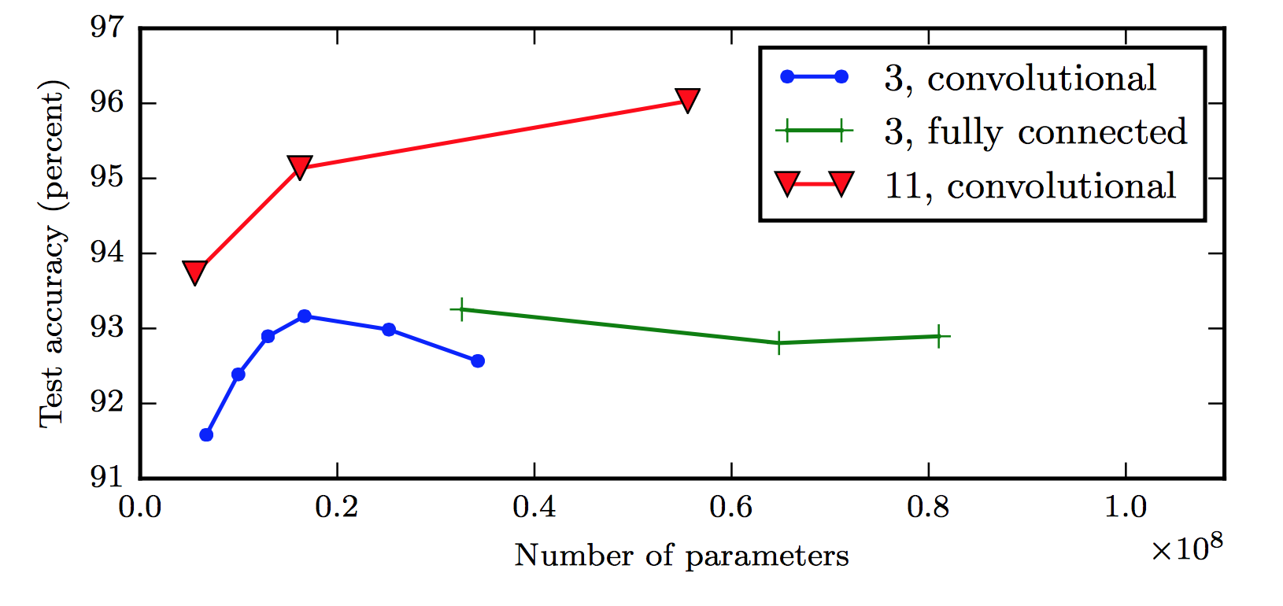
Large, Shallow Nets Overfit More
(Goodfellow 2017)

Slide 47

Why layers? Representation
Representation Matters

Slide 48

Learning Multiple Components

Slide 49

Depth = Repeated Compositions

Slide 50
Review of Feed Forward Artificial Neural Networks
Anatomy of a NN
Design choices
Activation function
Loss function
Output units
Architecture
Learning

Slide 51
Review of Feed Forward Artificial Neural Networks
Anatomy of a NN
Design choices
Activation function
Loss function
Output units
Architecture
Learning(more next lecture)
Basics ideas of optimizer
Backprop

Slide 52
Heart Data
response variable Y
is Yes/No
Age | Sex | ChestPain | RestBP | Chol | Fbs | RestECG | MaxHR | ExAng | Oldpeak | Slope | Ca | Thal | AHD
63 | 1 | typical | 145 | 233 | 1 | 2 | 150 | 0 | 2.3 | 3 | 0.0 | fixed | No
67 | 1 | asymptomatic | 160 | 286 | 0 | 2 | 108 | 1 | 1.5 | 2 | 3.0 | normal | Yes
67 | 1 | asymptomatic | 120 | 229 | 0 | 2 | 129 | 1 | 2.6 | 2 | 2.0 | reversable | Yes
37 | 1 | nonanginal | 130 | 250 | 0 | 0 | 187 | 0 | 3.5 | 3 | 0.0 | normal | No
41 | 0 | nontypical | 130 | 204 | 0 | 2 | 172 | 0 | 1.4 | 1 | 0.0 | normal | No

Slide 53





Basic idea of learning
Start with Regression or Logistic Regression
Classification
Regression
f(X)$=\frac{1}{{1+e}^{−W^{T}X}}$
f$\left(X\right)=W^{T}X$
$$W^{T}=\left[W_{0},W_{1},…, W_{4}\right]$$
$= [β_{0}, β_{1},…, β_{4}]$
$$x_{1}$$
$$x_{2}$$
$$Y=f(β_{0}+β_{1}x_{1}+β_{2}x_{2}+β_{3}x_{3}+β_{4}x_{4})$$
$$x_{3}$$
$$x_{4}$$
Intercept or Bias
Coefficients or Weights

Slide 54



But what is the idea?
Start with all randomly selected weights. Most likely it will perform horribly.
For example, in our heart data, the model will be giving us the wrong answer.
$$MaxHR=200$$
$$Age=52$$
Correct answer
$$\hat{p}=0.9→Yes$$
y=No
$$Sex=Male$$
$$Chol=152$$
Bad Computer

Slide 55




But what is the idea?
Start with all randomly selected weights. Most likely it will perform horribly.
For example, in our heart data, the model will be giving us the wrong answer.
$$MaxHR=170$$
$$Age=42$$
Correct answer
$$\hat{p}=0.4→No$$
y=Yes
$$Sex=Male$$
$$Chol=342$$
Bad Computer

Slide 56
But what is the idea?
Loss Function: Takes all of these results and averages them and tells us how bad or good the computer or those weights are.
Telling the computer how bad or good is, does not help.
You want to tell it how to change those weights so it gets better.
Loss function: $ℒ\left(w_{0},w_{1},w_{2},w_{3},w_{4}\right)$
For now let’s only consider one weight, $ℒ\left(w_{1}\right)$

Slide 57
But what is the idea?
Trial and error:
Change the weights and see the effect.
This can take long long time especially in NN where we have millions of weights to adjust.

Slide 58



Minimizing the Loss function
Ideally we want to know the value of $w_{1}$ that gives the minimul $ℒ\left(W\right)$
To find the optimal point of a function $ℒ\left(W\right)$
And find the $W$ that satisfies that equation. Sometimes there is no explicit solution for that.
$$\frac{dℒ(W)}{dW}=0$$

Slide 59
Minimizing the Loss function
A more flexible method is
Start from any point
Determine which direction to go to reduce the loss (left or right)
Specifically, we can calculate the slope of the function at this point
Shift to the right if slope is negative or shift to the left if slope is positive
Repeat

Slide 60
Minimization of the Loss Function
If the step is proportional to the slope then we can avoid overshooting the minimum.
Question: What is the mathematical function that describes the slope?
Question: How do we generalize this to more than one predictor?
Question: What do you think it is a good approach for telling the model how to change (what is the step size) to become better?

Slide 61
Minimization of the Loss Function
If the step is proportional to the slope then you avoid overshooting the minimum.
Question: What is the mathematical function that describes the slope? Derivative
Question: How do we generalize this to more than one predictor?
Take the derivative with respect to each coefficient and do the same sequentially
Question: What do you think it is a good approach for telling the model how to change (what is the step size) to become better?
More on this later

Slide 62



Let’s play the Pavlos game
We know that we want to go in the opposite direction of the derivative and we know we want to be making a step proportionally to the derivative.
Making a step means:
Learning Rate
$${w^{new}=w}^{old}+step$$
Opposite direction of the derivative means:
$${w^{new}=w}^{old}−λ\frac{dℒ}{dw}$$
Change to more conventional notation:
$${w^{(i+1)}=w}^{(i)}−λ\frac{dℒ}{dw}$$

Slide 63

Gradient Descent
Algorithm for optimization of first order to finding a minimum of a function.
It is an iterative method.
L is decreasing in the direction of the negative derivative.
The learning rate is controlled by the magnitude of $λ$.
$${w^{(i+1)}=w}^{(i)}−λ\frac{dℒ}{dw}$$
L
-
+
w

Slide 64
Considerations
We still need to derive the derivatives.
We need to know what is the learning rate or how to set it.
We need to avoid local minima.
Finally, the full likelihood function includes summing up all individual ‘errors’. Unless you are a statistician, this can be hundreds of thousands of examples.

Slide 65
Local vs Global Minima
L
𝛉

Slide 66
Local vs Global Minima
L
𝛉

Slide 67
Local vs Global Minima
No guarantee that we get the global minimum.
Question: What would be a good strategy?

Slide 68
Large data

Slide 69

Batch and Stochastic Gradient Descent
$$ℒ=−\sum_{i}{[y_{i}\log{p_{i}+\left(1−y_{i}\right)\log{(1−p_{i})]}}}$$
Instead of using all the examples for every step, use a subset of them (batch).
For each iteration k, use the following loss function to derive the derivatives:
which is an approximation to the full Loss function.
$$ℒ^{k}=−\sum_{i∈b^{k}}{[y_{i}\log{p_{i}+\left(1−y_{i}\right)\log{(1−p_{i})]}}}$$

Slide 70
Batch and Stochastic Gradient Descent
Full Likelihood:
L
Batch Likelihood:
𝛉

Slide 71
Batch and Stochastic Gradient Descent
Full Likelihood:
L
Batch Likelihood:
𝛉

Slide 72
Batch and Stochastic Gradient Descent
Full Likelihood:
L
Batch Likelihood:
𝛉

Slide 73
Batch and Stochastic Gradient Descent
Full Likelihood:
L
Batch Likelihood:
𝛉

Slide 74
Batch and Stochastic Gradient Descent
Full Likelihood:
L
Batch Likelihood:
𝛉

Slide 75
Batch and Stochastic Gradient Descent
Full Likelihood:
L
Batch Likelihood:
𝛉

Slide 76
Batch and Stochastic Gradient Descent
Full Likelihood:
L
Batch Likelihood:
𝛉

Slide 77
Batch and Stochastic Gradient Descent
Full Likelihood:
L
Batch Likelihood:
𝛉

Slide 78
Batch and Stochastic Gradient Descent
Full Likelihood:
L
Batch Likelihood:
𝛉

Slide 79

Learning Rate
There are many alternative methods which address how to set or adjust the learning rate, using the derivative or second derivatives and or the momentum. To be discussed in the next lectures on NN.
NEXT LECTURE
J. Nocedal y S. Wright, “Numerical optimization”, Springer, 1999 🔗
TLDR: J. Bullinaria, “Learning with Momentum, Conjugate Gradient Learning”, 2015 🔗

Slide 80
Considerations
We still need to derive the derivatives.
We need to know what is the learning rate or how to set it.
We need to avoid local minima.
Finally, the full likelihood function includes summing up all individual ‘errors’. Unless you are a statistician, this can be hundreds of thousands of examples.

Slide 81
Considerations
We still need to derive the derivatives.
We need to know what is the learning rate or how to set it.
We need to avoid local minima.
Finally, the full likelihood function includes summing up all individual ‘errors’. Unless you are a statistician, this can be hundreds of thousands of examples.

Slide 82
Review of Feed Forward Artificial Neural Networks
Anatomy of a NN
Design choices
Activation function
Loss function
Output units
Architecture
Learning (more next lecture)
Basics ideas of optimizer
Backprop

Slide 83
Derivatives: Linear Regression

Slide 84
Derivatives: Logistic Regression
Can we do it?
Wolfram Alpha can do it for us!
We need a general formalism to deal with these derivatives.

Slide 85

Backprop: Chain Rule
Chain rule for computing gradients:
$y=g\left(x\right) z=f\left(y\right)=f\left(g\left(x\right)\right)$
For longer chains
$$y=g\left(x \right) z=f\left(y\right)=f\left(g\left(x \right)\right)$$
$$\frac{∂z}{∂x_{i}}=\sum_{j}{\frac{∂z}{∂y_{j}}\frac{∂y_{j}}{∂x_{i}}}$$
$$\frac{∂z}{∂x}=\frac{∂z}{∂y}\frac{∂y}{∂x}$$

Slide 86



Logistic Regression derivatives
For logistic regression, the –ve log of the likelihood is:
$$ℒ=\sum_{i}{ℒ_{i}}=−\sum_{i}{\log{L_{i}}}{=−\sum_{i}{[y_{i}\log{p_{i}+\left(1−y_{i}\right)\log{(1−p_{i})]}}}}$$
$$ℒ_{i}={−y}_{i}\log{\frac{1}{1+e^{−W^{T}X}}−\left(1−y_{i}\right)\log{(1−\frac{1}{1+e^{−W^{T}X}})}}$$
To simplify the analysis let us split it into two parts,
$$ℒ_{i}=ℒ_{i}^{A}+ℒ_{i}^{B}$$
So the derivative with respect to W is:
$\frac{∂ℒ}{∂W}=\sum_{i}{\frac{∂ℒ_{i}}{∂W}}=\sum_{i}{(}\frac{∂ℒ_{i}^{A}}{∂W}$+ $\frac{∂ℒ_{i}^{B}}{∂W}$)

Slide 87

$$ℒ_{i}^{A}={−y}_{i}\log{\frac{1}{1+e^{−W^{T}X}}}$$
Variables | Partial derivatives | Partial derivatives
$$ξ_{1}=−W^{T}X$$ | $$\frac{∂ξ_{1}}{∂W}=−X$$ | $$\frac{∂ξ_{1}}{∂W}=−X$$
$$ξ_{2}={e^{ξ_{1}}=e}^{−W^{T}X}$$ | $$\frac{∂ξ_{2}}{∂ξ_{1}}=e^{ξ_{1}}$$ | $$\frac{∂ξ_{2}}{∂ξ_{1}}=e^{−W^{T}X}$$
$$ξ_{3}=1+ξ_{2}=1+e^{−W^{T}X}$$ | $$\frac{∂ξ_{3}}{∂ξ_{2}}=1$$ | $\frac{∂ξ_{3}}{∂ξ_{2}}=$1
$$ξ_{4}=\frac{1}{ξ_{3}}=\frac{1}{1+e^{−W^{T}X}}=p$$ | $$\frac{∂ξ_{4}}{∂ξ_{3}}=−\frac{1}{ξ_{3}^{2}}$$ | $$\frac{∂ξ_{4}}{∂ξ_{3}}=−\frac{1}{{\left(1+e^{−W^{T}X}\right)}^{2}}$$
$$ξ_{5}=\log{ξ_{4}=\log{p =}\log{\frac{1}{1+e^{−W^{T}X}}}}$$ | $$\frac{∂ξ_{5}}{∂ξ_{4}}=\frac{1}{ξ_{4}}$$ | $$\frac{∂ξ_{5}}{∂ξ_{4}}=1+e^{−W^{T}X}$$
$$ℒ_{i}^{A}=−yξ_{5}$$ | $$\frac{∂ℒ}{∂ξ_{5}}=−y$$ | $$\frac{∂ℒ}{∂ξ_{5}}=−y$$
$$\frac{∂ℒ_{i}^{A}}{∂W}=\frac{∂ℒ_{i}}{∂ξ_{5}}\frac{∂ξ_{5}}{∂ξ_{4}}\frac{∂ξ_{4}}{∂ξ_{3}}\frac{∂ξ_{3}}{∂ξ_{2}}\frac{∂ξ_{2}}{∂ξ_{1}}\frac{∂ξ_{1}}{∂W}$$ |  | $${\frac{∂ℒ_{i}^{A}}{∂W}=−yXe}^{−W^{T}X}\frac{1}{{\left(1+e^{−W^{T}X}\right)}^{}}$$

Slide 88


$$ℒ_{i}^{B}={−(1−y}_{i})\log{[1−\frac{1}{1+e^{−W^{T}X}}]}$$
Variables | derivatives | Partial derivatives wrt to X,W
$$ξ_{1}=−W^{T}X$$ | $$\frac{∂ξ_{1}}{∂W}=−X$$ | $$\frac{∂ξ_{1}}{∂W}=−X$$
$$ξ_{2}={e^{ξ_{1}}=e}^{−W^{T}X}$$ | $$\frac{∂ξ_{2}}{∂ξ_{1}}=e^{ξ_{1}}$$ | $$\frac{∂ξ_{2}}{∂ξ_{1}}=e^{−W^{T}X}$$
$$ξ_{3}=1+ξ_{2}=1+e^{−W^{T}X}$$ | $$\frac{∂ξ_{3}}{∂ξ_{2}}=1$$ | $\frac{∂ξ_{3}}{∂2}=$1
$$ξ_{4}=\frac{1}{ξ_{3}}=\frac{1}{1+e^{−W^{T}X}}=p$$ | $$\frac{∂ξ_{4}}{∂ξ_{3}}=−\frac{1}{ξ_{3}^{2}}$$ | $$\frac{∂ξ_{4}}{∂ξ_{3}}=−\frac{1}{{\left(1+e^{−W^{T}X}\right)}^{2}}$$
$$ξ_{5}=1−ξ_{4}=1−\frac{1}{1+e^{−W^{T}X}}$$ | $$\frac{∂ξ_{5}}{∂ξ_{4}}=−1$$ | $\frac{∂ξ_{5}}{∂ξ_{4}}=$-1
$$ξ_{6}=\log{ξ_{5}=\log{(1−p) =}\log{\frac{1}{1+e^{−W^{T}X}}}}$$ | $$\frac{∂ξ_{6}}{∂ξ_{5}}=\frac{1}{ξ_{5}}$$ | $$\frac{∂ξ_{6}}{∂ξ_{5}}=\frac{1+e^{−W^{T}X} }{e^{−W^{T}X}}$$
$$ℒ_{i}^{B}=(1−y)ξ_{6}$$ | $$\frac{∂ℒ}{∂ξ_{6}}=1−y$$ | $$\frac{∂ℒ}{∂ξ_{6}}=1−y$$
$$\frac{∂ℒ_{i}^{B}}{∂W}=\frac{∂ℒ_{i}^{B}}{∂ξ_{6}}\frac{∂ξ_{6}}{∂ξ_{5}}\frac{∂ξ_{5}}{∂ξ_{4}}\frac{∂ξ_{4}}{∂ξ_{3}}\frac{∂ξ_{3}}{∂ξ_{2}}\frac{∂ξ_{2}}{∂ξ_{1}}\frac{∂ξ_{1}}{∂W}$$ |  | $$\frac{∂ℒ_{i}^{B}}{∂W}=(1−y)X\frac{1}{{\left(1+e^{−W^{T}X}\right)}^{}}$$

Slide 89











Backpropagation: Logistic Regression Revisited
Affine
Activation
Loss Fun
$$ℒ(β)=\sum_{i}^{n}{ℒ_{i}\left(β\right)}$$
$$p=\frac{1}{1+e^{−h}}$$
$$X$$
$$h=β_{0}+β_{1}X$$
$\frac{∂ℒ}{∂p}$ $\frac{∂p}{∂h}$ $\frac{∂h}{∂β}$
$\frac{∂ℒ}{∂p}$ $\frac{∂p}{∂h}$
$$\frac{∂ℒ}{∂p}$$
$$\frac{∂h}{∂β_{1}}=X,\frac{dℒ}{dβ_{0}}=1$$
$$\frac{∂p}{∂h}=σ(h)(1−σ\left(h\right))$$
$$\frac{∂ℒ}{∂p}=−y\frac{1}{p}−\left(1−y\right)\frac{1}{1−p}$$
$$\frac{∂ℒ}{∂β_{1}}=−Xσ\left(h\right)\left(1−σ\left(h\right)\right)[y\frac{1}{p}+\left(1−y\right)\frac{1}{1−p}]$$
$$\frac{∂ℒ}{∂β_{0 }}=−σ\left(h\right)\left(1−σ\left(h\right)\right)[ y\frac{1}{p}+\left(1−y\right)\frac{1}{1−p}]$$

Slide 90



Backpropagation
Derivatives need to be evaluated at some values of X, y and W.
But since we have an expression, we can build a function that takes as input X, y, W and returns the derivatives and then we can use gradient descent to update.
This approach works well but it does not generalize. For example if the network is changed, we need to write a new function to evaluate the derivatives.
For example this network will need a different function for the derivatives,
W₁
$$W_{3}$$
$$X$$
$$Y$$
W₂

Slide 91





Backpropagation
Derivatives need to be evaluated at some values of X, y and W.
But since we have an expression, we can build a function that takes as input X, y, W and returns the derivatives and then we can use gradient descent to update.
This approach works well but it does not generalize. For example if the network is changed, we need to write a new function to evaluate the derivatives.
Than this one:
W₁
$$W_{3}$$
$$W_{5}$$
$$X$$
$$Y$$
W₂
$$W_{4}$$

Slide 92

Backpropagation. Pavlos game #456
Need to find a formalism to calculate the derivatives of the loss function wrt to weights that is:
Flexible enough that adding a node or a layer or changing something in the network won’t require to re-derive the functional form from scratch.
It is exact
It is computationally efficient
Hints:
Remember we only need to evaluate the derivatives at $X_{i}, y_{i}$ and $W^{(k)}$
We should take advantage of the chain rule we learned before

Slide 93

Idea 1: Evaluate the derivative at: X={3}, y=1, W=3
Variables | derivatives | Value of the variable | Value of the partial derivative | $$\frac{dξ_{n}}{dW}$$
$$ξ_{1}=−W^{T}X$$ | $$\frac{∂ξ_{1}}{∂W}=−X$$ | $$−9$$ | -3 | -3
$$ξ_{2}={e^{ξ_{1}}=e}^{−W^{T}X}$$ | $$\frac{∂ξ_{2}}{∂ξ_{1}}=e^{ξ_{1}}$$ | $$e^{−9}$$ | $$e^{−9}$$ | -3$e^{−9}$
$$ξ_{3}=1+ξ_{2}=1+e^{−W^{T}X}$$ | $$\frac{∂ξ_{3}}{∂ξ_{2}}=1$$ | 1+$e^{−9}$ | 1 | -3$e^{−9}$
$$ξ_{4}=\frac{1}{ξ_{3}}=\frac{1}{1+e^{−W^{T}X}}=p$$ | $$\frac{∂ξ_{4}}{∂ξ_{3}}=−\frac{1}{ξ_{3}^{2}}$$ | $$\frac{1}{1+e^{−9}}$$ | $${\left(\frac{1}{1+e^{−9}}\right)}^{2}$$ | -3$e^{−9}{\left(\frac{1}{1+e^{−9}}\right)}^{2}$
$$ξ_{5}=\log{ξ_{4}=\log{p =}\log{\frac{1}{1+e^{−W^{T}X}}}}$$ | $$\frac{∂ξ_{5}}{∂ξ_{4}}=\frac{1}{ξ_{4}}$$ | $$\log{\frac{1}{1+e^{−9}}}$$ | $$1+e^{−9}$$ | -3$e^{−9}{\left(\frac{1}{1+e^{−9}}\right)}^{}$
$$ℒ_{i}^{A}=−yξ_{5}$$ | $$\frac{∂ℒ}{∂ξ_{5}}=−y$$ | $$−\log{\frac{1}{1+e^{−9}}}$$ | $$−1$$ | 3$e^{−9}{\left(\frac{1}{1+e^{−9}}\right)}^{}$
$$\frac{∂ℒ_{i}^{A}}{∂W}=\frac{∂ℒ_{i}}{∂ξ_{5}}\frac{∂ξ_{5}}{∂ξ_{4}}\frac{∂ξ_{4}}{∂ξ_{3}}\frac{∂ξ_{3}}{∂ξ_{2}}\frac{∂ξ_{2}}{∂ξ_{1}}\frac{∂ξ_{1}}{∂W}$$ |  |  | $$−3$$ | 0.00037018372

Slide 94

Basic functions
We still need to derive derivatives ☹
Variables | derivatives | Value of the variable | Value of the partial derivative | $$\frac{dξ_{n}}{dW}$$
$$ξ_{1}=−W^{T}X$$ | $$\frac{∂ξ_{1}}{∂W}=−X$$ | $$−9$$ | -3 | -3
$$ξ_{2}={e^{ξ_{1}}=e}^{−W^{T}X}$$ | $$\frac{∂ξ_{2}}{d∂ξ_{1}}=e^{ξ_{1}}$$ | $$e^{−9}$$ | $$e^{−9}$$ | -3$e^{−9}$
$$ξ_{3}=1+ξ_{2}=1+e^{−W^{T}X}$$ | $$\frac{∂ξ_{3}}{∂ξ_{2}}=1$$ | 1+$e^{−9}$ | 1 | -3$e^{−9}$
$$ξ_{4}=\frac{1}{ξ_{3}}=\frac{1}{1+e^{−W^{T}X}}=p$$ | $$\frac{∂ξ_{4}}{∂ξ_{3}}=−\frac{1}{ξ_{3}^{2}}$$ | $$\frac{1}{1+e^{−9}}$$ | $${\left(\frac{1}{1+e^{−9}}\right)}^{2}$$ | -3$e^{−9}{\left(\frac{1}{1+e^{−9}}\right)}^{2}$
$$ξ_{5}=\log{ξ_{4}=\log{p =}\log{\frac{1}{1+e^{−W^{T}X}}}}$$ | $$\frac{∂ξ_{5}}{∂ξ_{4}}=\frac{1}{ξ_{4}}$$ | $$\log{\frac{1}{1+e^{−9}}}$$ | $$1+e^{−9}$$ | -3$e^{−9}{\left(\frac{1}{1+e^{−9}}\right)}^{}$
$$ℒ_{i}^{A}=−yξ_{5}$$ | $$\frac{∂ℒ}{∂ξ_{5}}=−y$$ | $$−\log{\frac{1}{1+e^{−9}}}$$ | $$−1$$ | 3$e^{−9}{\left(\frac{1}{1+e^{−9}}\right)}^{}$
$$\frac{∂ℒ_{i}^{A}}{∂W}=\frac{∂ℒ_{i}}{∂ξ_{5}}\frac{∂ξ_{5}}{∂ξ_{4}}\frac{∂ξ_{4}}{∂ξ_{3}}\frac{∂ξ_{3}}{∂ξ_{2}}\frac{∂ξ_{2}}{∂ξ_{1}}\frac{∂ξ_{1}}{∂W}$$ |  |  | $$−3$$ | 0.00037018372

Slide 95

Basic functions
Notice though those are basic functions that my grandparent can do
$$ξ_{0}=X$$ | $$\frac{∂ξ_{0}}{∂X}=1$$ | def x0(x): return X | def derx0(): return 1
$$ξ_{1}=−W^{T}ξ_{0}$$ | $$\frac{∂ξ_{1}}{∂W}=−X$$ | def x1(a,x): return –a*X | def derx1(a,x): return -a
$$ξ_{2}=e^{ξ_{1}}$$ | $$\frac{∂ξ_{2}}{∂ξ_{1}}=e^{ξ_{1}}$$ | def x2(x): return np.exp(x) | def derx2(x): return np.exp(x)
$$ξ_{3}=1+ξ_{2}$$ | $$\frac{∂ξ_{3}}{∂ξ_{2}}=1$$ | def x3(x): return 1+x | def derx3(x): return 1
$$ξ_{4}=\frac{1}{ξ_{3}}$$ | $$\frac{∂ξ_{4}}{∂ξ_{3}}=−\frac{1}{ξ_{3}^{2}}$$ | def der1(x): return 1/(x) | def derx4(x): return -(1/x)**(2)
$$ξ_{5}=\log{ξ_{4}}$$ | $$\frac{∂ξ_{5}}{∂ξ_{4}}=\frac{1}{ξ_{4}}$$ | def der1(x): return np.log(x) | def derx5(x) return 1/x
$$ℒ_{i}^{A}=−yξ_{5}$$ | $$\frac{∂ℒ}{∂ξ_{5}}=−y$$ | def der1(y,x): return –y*x | def derL(y): return -y

Slide 96


Autograd: Auto-differentiation
1. We specify the network structure
W₁
$$W_{3}$$
$$X$$
$$W_{5}$$
$$Y$$
W₂
$$W_{4}$$
2. We create the computational graph …
What is computational graph?

Slide 97


















$$ξ_{5}=log{\frac{1}{1+e^{−W^{T}X}}}$$
Computational Graph
$$ξ_{4}=\frac{1}{1+e^{−W^{T}X}}$$
$$÷$$
Log
$$ξ_{7}=log(1−{\frac{1}{1+e^{−W^{T}X}})}$$
$$ξ_{3}={1+e}^{−W^{T}X}$$
$$+$$
log
-
1
$$exp$$
$$ξ_{6}=1−{\frac{1}{1+e^{−W^{T}X}}}$$
1-y
$$ξ_{2}=e^{−ξ_{1}} \\ ξ_{2}^{′}={−e}^{−ξ_{1}}$$
$$−$$
$$×$$
$$ξ_{1}=W^{T}X$$ $ξ_{1}^{′}$=X
y
$$×$$
$$×$$
$$ξ_{8}=\left(1−y\right)log(1−{\frac{1}{1+e^{−W^{T}X}})}$$
$$ξ_{9}=ylog({\frac{1}{1+e^{−W^{T}X}})}$$
W
X
$$+$$
$$ξ_{0}=W$$
$$−ℒ=ξ_{9}=ylog({\frac{1}{1+e^{−W^{T}X}})}+ \left(1−y\right)log(1−{\frac{1}{1+e^{−W^{T}X}})}$$

Slide 98
Autograd (cont)
1. We specify the network structure
W₁
$$W_{3}$$
$$X$$
$$W_{5}$$
$$Y$$
W₂
$$W_{4}$$
We create the computational graph.
At each node of the graph we build two functions: the evaluation of the variable and its partial derivative with respect to the previous variable (as shown in the table few slides back)
Now we can either go forward or backward depending on the situation. In general, forward is easier to implement and to understand. The difference is clearer when there are multiple nodes per layer.

Slide 99

Forward mode: Evaluate the derivative at: X={3}, y=1, W=3
Variables | derivatives | Value of the variable | Value of the partial derivative | $$\frac{dℒ}{dξ_{n}}$$
$$ξ_{1}=−W^{T}X$$ | $$\frac{∂ξ_{1}}{∂W}=−X$$ | $$−9$$ | -3 | -3
$$ξ_{2}={e^{ξ_{1}}=e}^{−W^{T}X}$$ | $$\frac{∂ξ_{2}}{∂ξ_{1}}=e^{ξ_{1}}$$ | $$e^{−9}$$ | $$e^{−9}$$ | -3$e^{−9}$
$$ξ_{3}=1+ξ_{2}=1+e^{−W^{T}X}$$ | $$\frac{∂ξ_{3}}{∂ξ_{2}}=1$$ | 1+$e^{−9}$ | 1 | -3$e^{−9}$
$$ξ_{4}=\frac{1}{ξ_{3}}=\frac{1}{1+e^{−W^{T}X}}=p$$ | $$\frac{∂ξ_{4}}{∂ξ_{3}}=−\frac{1}{ξ_{3}^{2}}$$ | $$\frac{1}{1+e^{−9}}$$ | $${\left(\frac{1}{1+e^{−9}}\right)}^{2}$$ | -3$e^{−9}{\left(\frac{1}{1+e^{−9}}\right)}^{2}$
$$ξ_{5}=\log{ξ_{4}=\log{p =}\log{\frac{1}{1+e^{−W^{T}X}}}}$$ | $$\frac{∂ξ_{5}}{∂ξ_{4}}=\frac{1}{ξ_{4}}$$ | $$\log{\frac{1}{1+e^{−9}}}$$ | $$1+e^{−9}$$ | -3$e^{−9}{\left(\frac{1}{1+e^{−9}}\right)}^{}$
$$ℒ_{i}^{A}=−yξ_{5}$$ | $$\frac{∂ℒ}{∂ξ_{5}}=−y$$ | $$−\log{\frac{1}{1+e^{−9}}}$$ | $$−1$$ | 3$e^{−9}{\left(\frac{1}{1+e^{−9}}\right)}^{}$
$$\frac{∂ℒ_{i}^{A}}{∂W}=\frac{∂ℒ_{i}}{∂ξ_{5}}\frac{∂ξ_{5}}{∂ξ_{4}}\frac{∂ξ_{4}}{∂ξ_{3}}\frac{∂ξ_{3}}{∂ξ_{2}}\frac{∂ξ_{2}}{∂ξ_{1}}\frac{∂ξ_{1}}{∂W}$$ |  |  | $$−3$$ | 0.00037018372

Slide 100

Backward mode: Evaluate the derivative at: X={3}, y=1, W=3
Variables | derivatives | Value of the variable | Value of the partial derivative
$$ξ_{1}=−W^{T}X$$ | $$\frac{∂ξ_{1}}{∂W}=−X$$ | $$−9$$ | -3
$$ξ_{2}={e^{ξ_{1}}=e}^{−W^{T}X}$$ | $$\frac{∂ξ_{2}}{∂ξ_{1}}=e^{ξ_{1}}$$ | $$e^{−9}$$ | $$e^{−9}$$
$$ξ_{3}=1+ξ_{2}=1+e^{−W^{T}X}$$ | $$\frac{∂ξ_{3}}{∂ξ_{2}}=1$$ | 1+$e^{−9}$ | 1
$$ξ_{4}=\frac{1}{ξ_{3}}=\frac{1}{1+e^{−W^{T}X}}=p$$ | $$\frac{∂ξ_{4}}{∂ξ_{3}}=−\frac{1}{ξ_{3}^{2}}$$ | $$\frac{1}{1+e^{−9}}$$ | $${\left(\frac{1}{1+e^{−9}}\right)}^{2}$$
$$ξ_{5}=\log{ξ_{4}=\log{p =}\log{\frac{1}{1+e^{−W^{T}X}}}}$$ | $$\frac{∂ξ_{5}}{∂ξ_{4}}=\frac{1}{ξ_{4}}$$ | $$\log{\frac{1}{1+e^{−9}}}$$ | $$1+e^{−9}$$
$$ℒ_{i}^{A}=−yξ_{5}$$ | $$\frac{∂ℒ}{∂ξ_{5}}=−y$$ | $$−\log{\frac{1}{1+e^{−9}}}$$ | $$−1$$
$$\frac{∂ℒ_{i}^{A}}{∂W}=\frac{∂ℒ_{i}}{∂ξ_{5}}\frac{∂ξ_{5}}{∂ξ_{4}}\frac{∂ξ_{4}}{∂ξ_{3}}\frac{∂ξ_{3}}{∂ξ_{2}}\frac{∂ξ_{2}}{∂ξ_{1}}\frac{∂ξ_{1}}{∂W}$$
Store all these values

